Slide 1
Demonstration of determination of SPI
Waikhom Rahul Singh
Scientist ‘B’
CFMS Guwahati
National Institute of Hydrology

Slide 2
Standardized Precipitation Index
The SPI (McKee et al. 1993) is a powerful, flexible index that is simple to calculate.
The SPI is based on the probability of precipitation for any time scale.
The probability of observed precipitation is then transformed into an index to represent quantitatively
Very effective in analyzing wet periods/cycles as it is in analyzing dry periods/cycles.

Slide 3
Standardized Precipitation Index
Strengths
Precipitation is the only input parameter.
It is flexible: it can be computed for multiple timescales
It is spatially consistent: it allows for comparisons between different locations in different climates
Since, SPI is normalized, it can be used to analyze wet period same as dry periods
Weaknesses
It can only quantify the precipitation deficit;
Values based on preliminary data may change, and values change as the period of record grows.

Slide 4
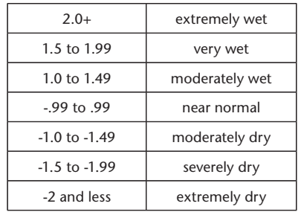
Standardized Precipitation Index
The SPI could also adapt to analyze other types of drought.
Soil moisture conditions respond to precipitation anomalies on a relatively short scale. Groundwater, streamflow and reservoir storage reflect the longer-term precipitation anomalies.
So, for example, one may want to look at a 1- or 2-month SPI for meteorological drought, anywhere from 1-month to 6-month SPI for agricultural drought, and something like 6-month up to 24-month SPI or more for hydrological drought analyses and applications

Slide 5
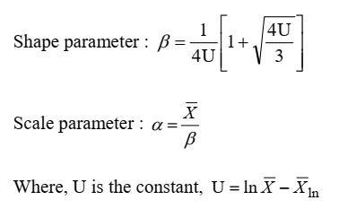
Computation of SPI
Step 1: Determination of monthly rainfall series ‘X’
Step 2: Calculation of the mean for the normalized precipitation values of the log-normal (ln) rainfall series
Step 3: Computation of shape and scale parameter

Slide 6
Computation of SPI
Step 4: Determination of the cumulative probability of an observed precipitation event for the given month and timescale for the station. Gamma probability distribution is commonly used:
Since gamma function is undefined for x = 0 and precipitation distribution may contain zero, the cumulative probability becomes:
Where , q is the probability of zero events in the data series

Slide 7
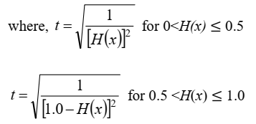
Computation of SPI
Step 5: The cumulative probability, H(x), is then transformed to the standard normal random variable “Z” with mean zero and variance one, which is the value of the SPI

Slide 8
Drought characteristics
Drought Period
Drought Severity/Intensity
Drought duration (Onset and Cessation)
Drought frequency
Drought geographical spread
Drought Severity
Drought Spell/ Drought Event
A drought event starts any time the SPI reaches an intensity of -1.0 or less and ends when the SPI becomes positive.

Slide 9
SPI Generator
Developed by NDMC 2018
Can calculate 20 timescales of SPI at once
Precipitation input can be daily, weekly and monthly
SPI outputs are in either weekly or monthly time aggregation
Program is available freely at https://drought.unl.edu/droughtmonitoring/SPI/SPIProgram.aspx

Slide 10
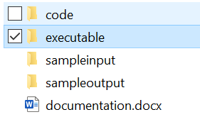
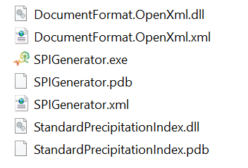
SPI Generator
The downloaded files has the following elements

Slide 11
SPI Generator: Input DATA
CSV
Space delimited
Tab delimited
Daily
Weekly
Monthly
Data can be with dates or single column
If single column, initial year and initial month must be indicated in the 2nd row
First row is reserved for naming the station

Slide 12
SPI Generator: TIMESCALES
Aggregate type
Weekly
Monthly
Time scales
1, 2, 3, 4, 5, 6, 7, 8, 9, 10, 11, 12, 18, 24, 36, 48, 60, 72, 84 and 96

Slide 13
SPI Generator: OUTPUTS
CSV
Space delimited
Excel (.xlsx)
Optional outputs
Drought periods and
Drought frequencies

Slide 14
IMD Grids in the study area

Slide 15
RESULTS AT IMD GRID 90.5 E & 25.5 N (Samanda sub-division)

Slide 19
Annual and Monsoon series of SPI at IMD GRID 90.5 E & 25.5 N (Samanda sub-division)

Slide 20
Drought Spells at IMD GRID 90.5 E & 25.5 N (Samanda sub-division)
SPI6
Event# | Start | End | Duration | Severity | Magnitude | Nature of Drought
1 | Jun-1901 | Mar-1902 | 9 | -1.12 | -6.28 | Moderate
2 | Mar-1903 | Nov-1903 | 8 | -2.14 | -6.99 | Extreme
3 | Jun-1906 | Jan-1907 | 7 | -1.11 | -3.61 | Moderate
4 | Mar-1908 | Mar-1910 | 24 | -2.86 | -18.68 | Extreme
5 | Jan-1911 | May-1911 | 4 | -1.14 | -2.69 | Moderate
6 | Mar-1915 | May-1915 | 2 | -1.04 | -1.4 | Moderate
7 | Feb-1916 | Apr-1916 | 2 | -1.65 | -2.91 | Severe
8 | Apr-1917 | Jan-1918 | 9 | -1.9 | -8.62 | Severe
9 | May-1918 | Jan-1920 | 20 | -1.95 | -12.98 | Severe
10 | Mar-1922 | Apr-1923 | 13 | -2 | -10.81 | Extreme
11 | Mar-1924 | Feb-1925 | 11 | -1.68 | -6.73 | Severe
12 | Mar-1932 | Aug-1932 | 5 | -1.06 | -2.57 | Moderate
13 | Apr-1935 | Feb-1940 | 58 | -3.03 | -44.59 | Extreme
14 | Dec-1940 | Apr-1941 | 4 | -1.27 | -4.06 | Moderate
15 | Aug-1944 | Feb-1946 | 18 | -1.51 | -14.07 | Severe
16 | Apr-1950 | Jul-1951 | 15 | -1.32 | -10.8 | Moderate
17 | Mar-1954 | May-1956 | 26 | -1.86 | -20.03 | Severe
18 | Feb-1958 | Apr-1958 | 2 | -1.09 | -1.16 | Moderate
19 | Apr-1960 | Dec-1960 | 8 | -2.81 | -6.72 | Extreme
20 | Sep-1961 | Apr-1964 | 31 | -2.07 | -32.66 | Extreme
21 | Feb-1967 | Apr-1968 | 14 | -2.42 | -18.14 | Extreme
22 | Dec-1969 | Nov-1970 | 11 | -2.35 | -10.13 | Extreme
23 | Jun-1981 | Dec-1982 | 18 | -1.35 | -14.71 | Moderate
24 | Jun-1983 | Dec-1983 | 6 | -1.31 | -5.32 | Moderate
25 | May-1985 | Jan-1987 | 20 | -1.83 | -19.39 | Severe
26 | Apr-1992 | Apr-1993 | 12 | -1.65 | -11.42 | Severe
27 | Nov-1994 | Jul-1995 | 8 | -1.65 | -7.65 | Severe
28 | Apr-1996 | May-1997 | 13 | -1.24 | -10.23 | Moderate
29 | Dec-1999 | Apr-2000 | 4 | -1.95 | -5.12 | Severe
30 | Oct-2000 | Apr-2001 | 6 | -1.8 | -7.94 | Severe
31 | Feb-2010 | Mar-2010 | 1 | -1.08 | -1.08 | Moderate
32 | Sep-2011 | Jun-2012 | 9 | -2.11 | -11.14 | Extreme
33 | Apr-2014 | May-2014 | 1 | -1.24 | -1.24 | Moderate
34 | Mar-2015 | Apr-2015 | 1 | -1.4 | -1.4 | Moderate
35 | Mar-2019 | Apr-2019 | 1 | -1.02 | -1.02 | Moderate

Slide 21
Drought Spells contd…
SPI12
Event# | Start | End | Duration (months) | Severity | Magnitude | Nature of Drought
1 | Apr-1908 | Feb-1912 | 46 | -1.07 | -29.14 | Moderate
2 | Jul-1916 | Aug-1918 | 25 | -1.12 | -18.9 | Moderate
3 | Aug-1919 | Jul-1921 | 23 | -1.05 | -9.11 | Moderate
4 | Jun-1924 | Jul-1927 | 37 | -1.07 | -14.1 | Moderate
5 | Sep-1936 | May-1948 | 140 | -1.28 | -83.3 | Moderate
6 | Sep-1961 | Jul-1964 | 34 | -1.89 | -39.23 | Severe
7 | May-1967 | Jul-1968 | 14 | -2 | -20.59 | Extreme
8 | Apr-1970 | Apr-1971 | 12 | -1.37 | -7.99 | Moderate
9 | Aug-1981 | Jun-1984 | 34 | -1.33 | -24.19 | Moderate
10 | Jun-1986 | Jun-1987 | 12 | -1.38 | -12.3 | Moderate
11 | May-1992 | Jul-1993 | 14 | -1.33 | -14.55 | Moderate
12 | May-1995 | Sep-1995 | 4 | -1.29 | -3.34 | Moderate
13 | Sep-1996 | Jun-1997 | 9 | -1.23 | -9.47 | Moderate
14 | Jul-2000 | Jun-2001 | 11 | -1.09 | -9.94 | Moderate
15 | Oct-2011 | May-2013 | 19 | -1.33 | -13.45 | Moderate

Slide 22
Drought Spells contd…
SPI24
Event# | Start | End | Duration | Severity | Magnitude | Nature of Drought
1 | Apr-1909 | Oct-1927 | 222 | -1.2 | -123.26 | Moderate
2 | Jun-1937 | Mar-1953 | 189 | -1.17 | -108.23 | Moderate
3 | Jun-1962 | Nov-1965 | 41 | -1.68 | -38.38 | Severe
4 | Jun-1967 | Aug-1971 | 50 | -1.51 | -44.54 | Severe
5 | May-1982 | Jul-1984 | 26 | -1.15 | -19.57 | Moderate
6 | Aug-1986 | Aug-1987 | 12 | -1.17 | -10.83 | Moderate
7 | Oct-1992 | Jun-1997 | 56 | -1.1 | -30.81 | Moderate
SPI48
Event# | Start | End | Duration | Severity | Magnitude | Nature of Drought
1 | Sep-1909 | Oct-1928 | 229 | -1.08 | -153.4 | Moderate
2 | Oct-1938 | Aug-1972 | 406 | -1.36 | -282.58 | Moderate

